Slide 1




C23-PC612

Slide 2
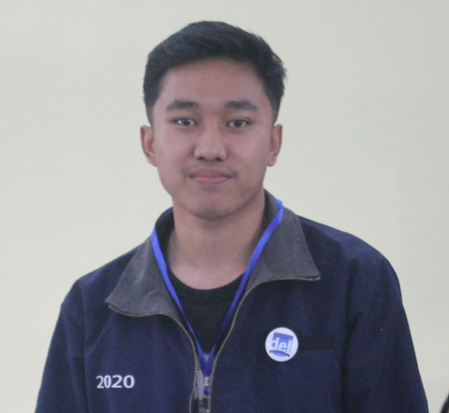
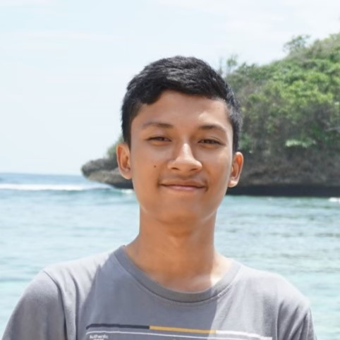
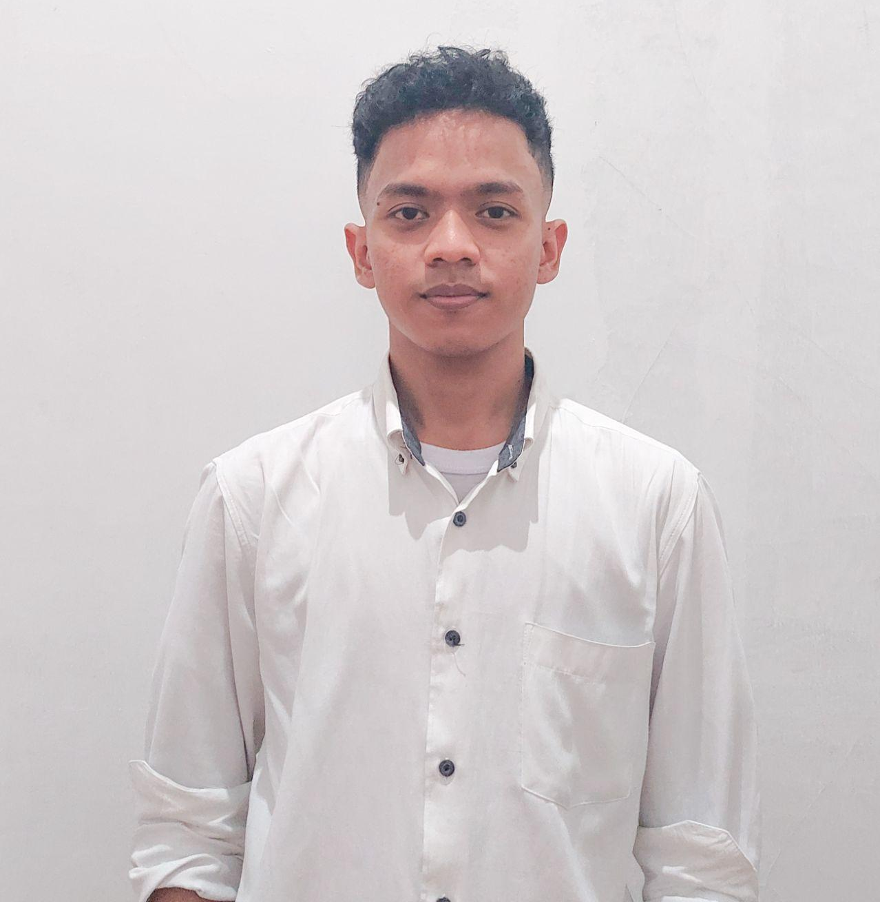


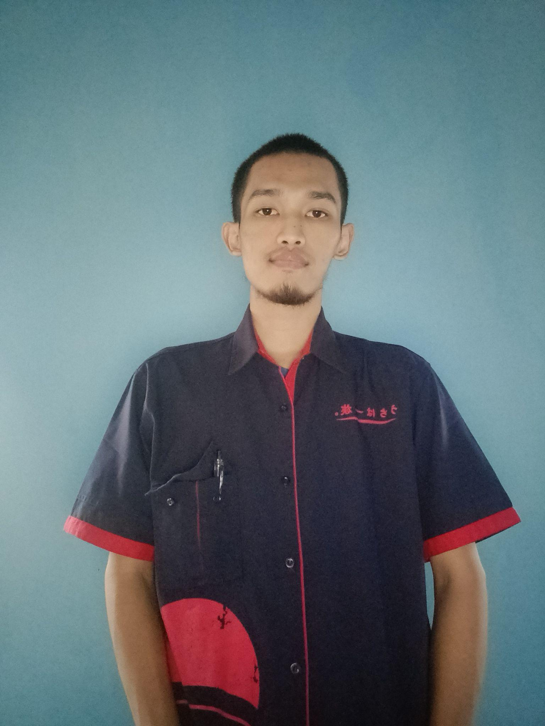
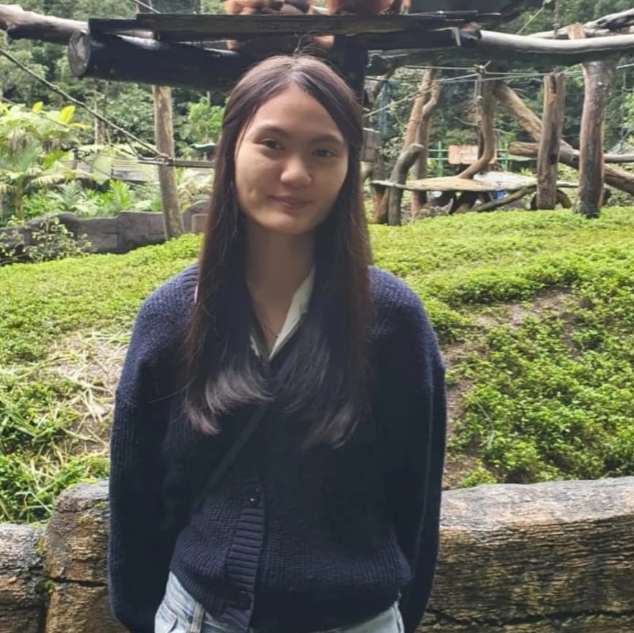
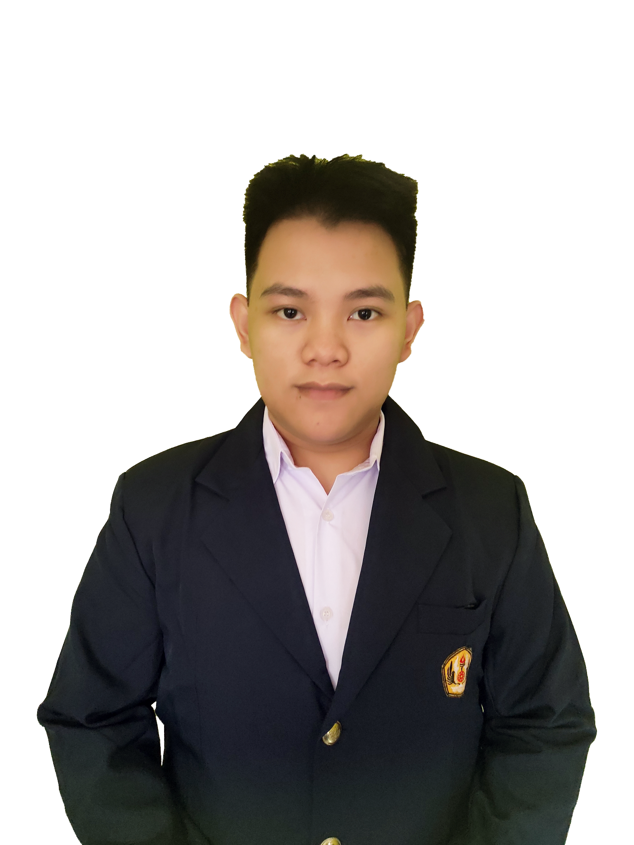

Ivanston Simbolon A030DSX3479
M. Nizar Anwari C038DSX1944
Dimas Prasetyo C288DSX3328
Nu’man Zainul R. M125DKX4760
Rachel Caroline N. M228DSY2774
Tegar Ridwansyah M295DSX1339

Slide 3
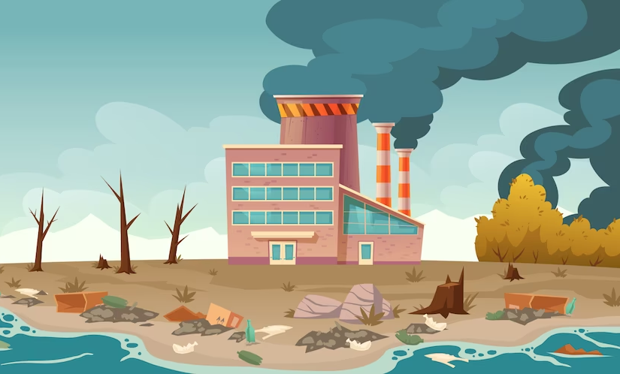
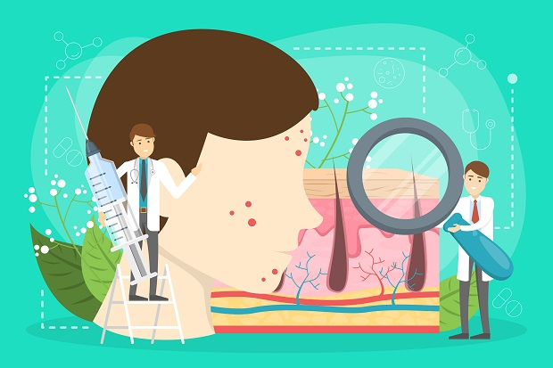
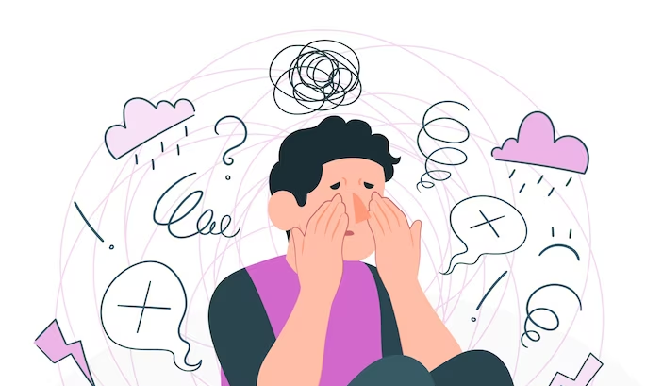
Issue
Factor 1
Factor 2
Factor 3
Environmental factors and unhealthy habits can cause facial skin problems.
Do not have the cost and time required to consult a dermatologist.
Some people are embarrassed and even afraid to consult a dermatologist

Slide 4
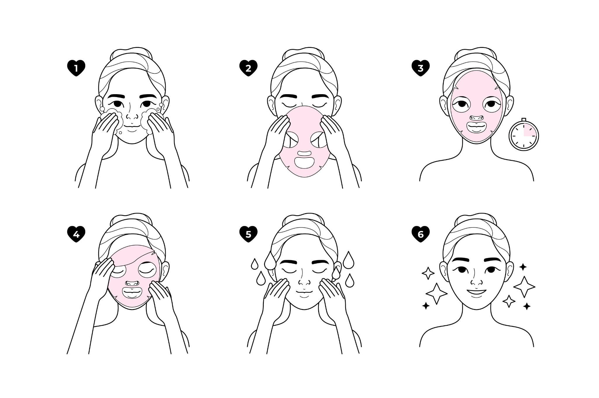
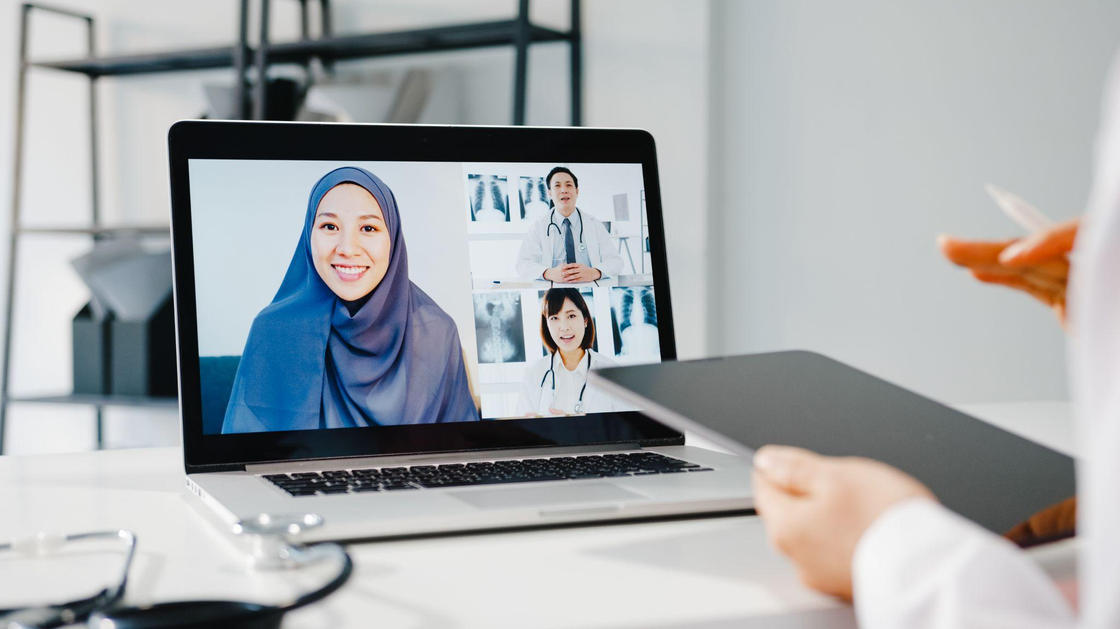
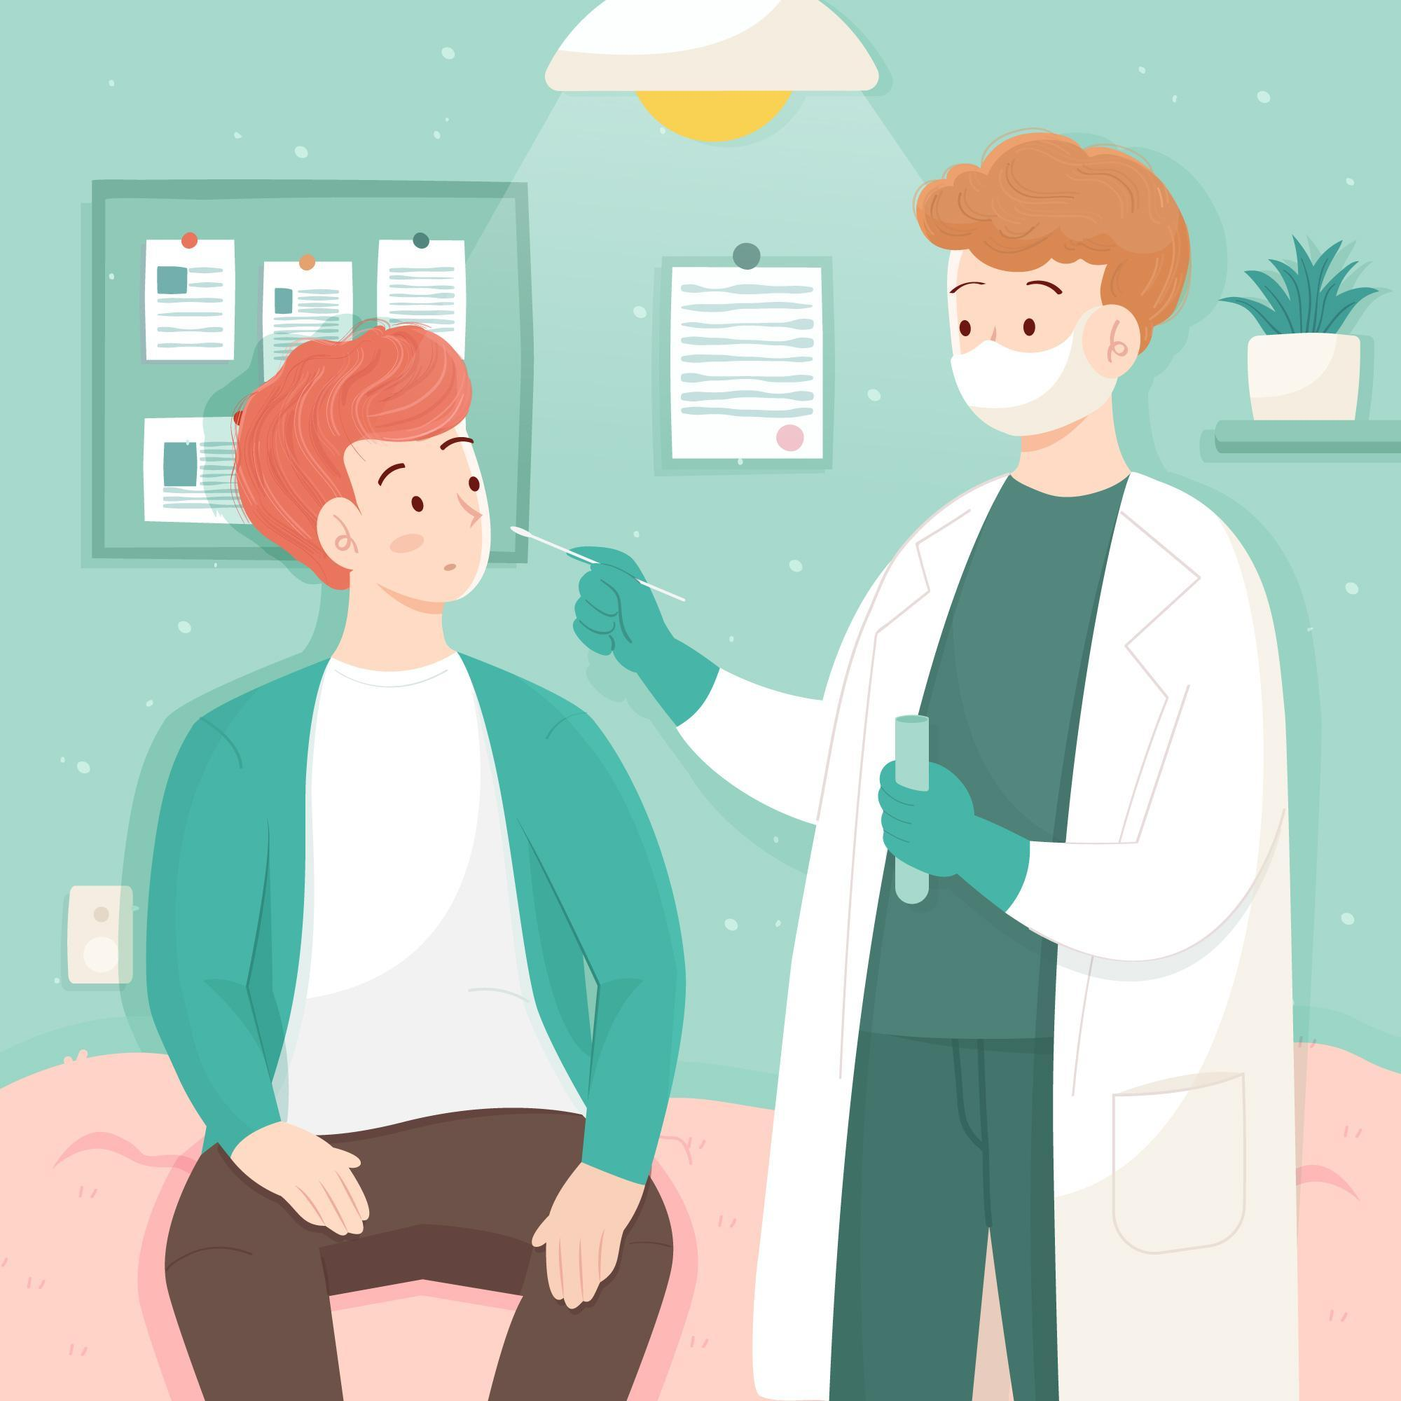
Our Solution
Factor 1
Factor 2
Factor 3
FacialBot provides tips and education on dealing with and caring for our facial skin so that we avoid bad habits with our faces
Benefit people who have little time to go to the doctor and do not have enough money to do a facial skin examination
FacialBot has an AI feature, people can know the disease in advance and be ready for treatment by a doctor

Slide 5
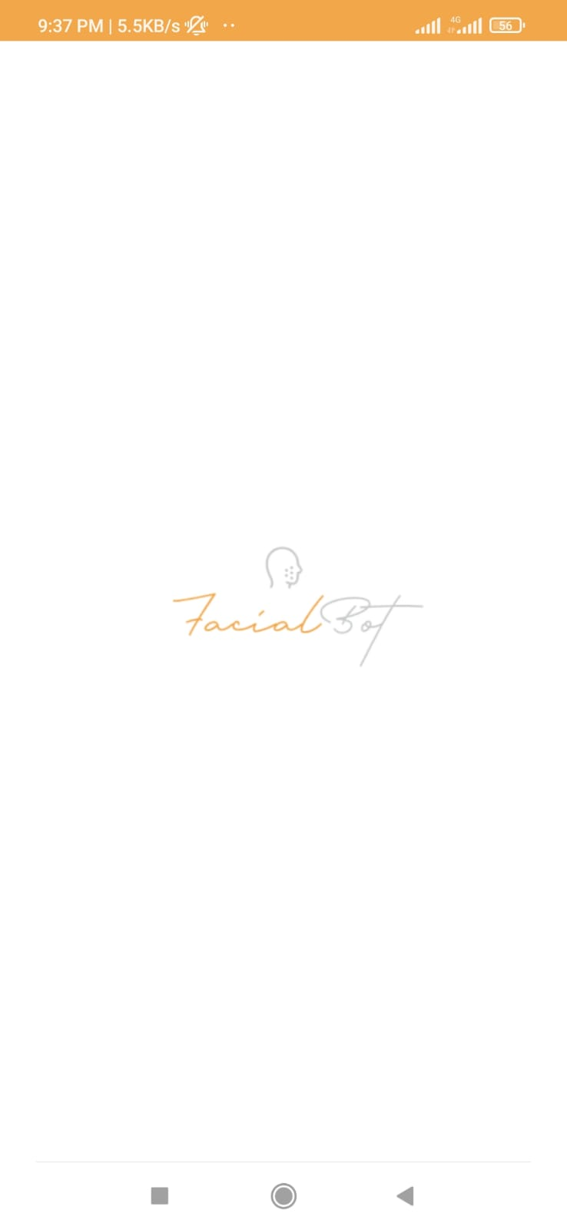
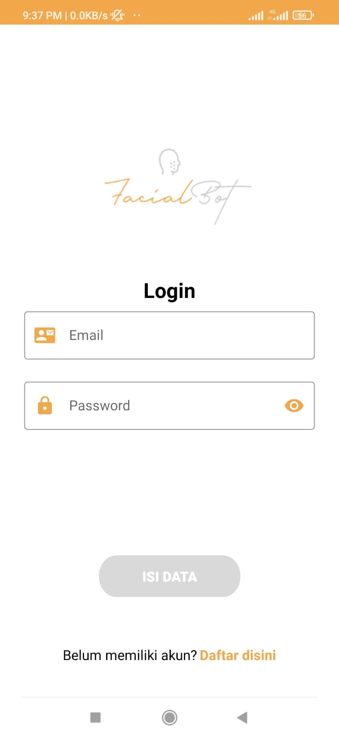
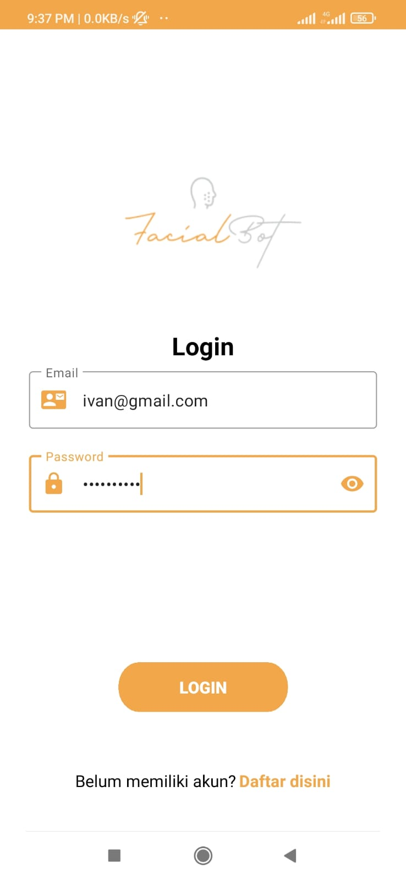
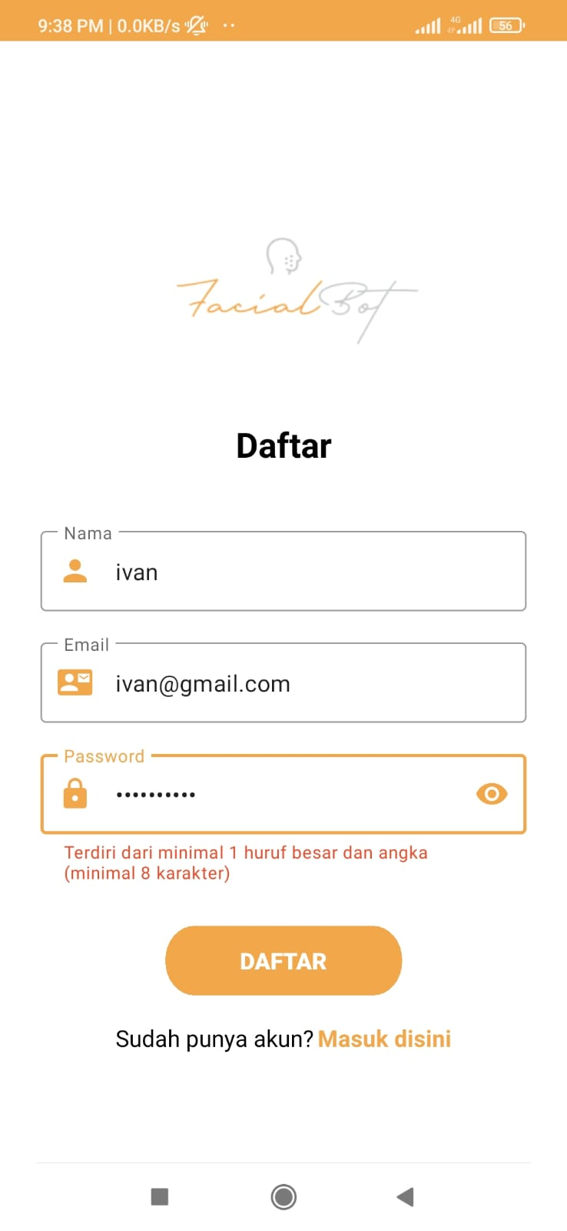
Android App

Slide 6
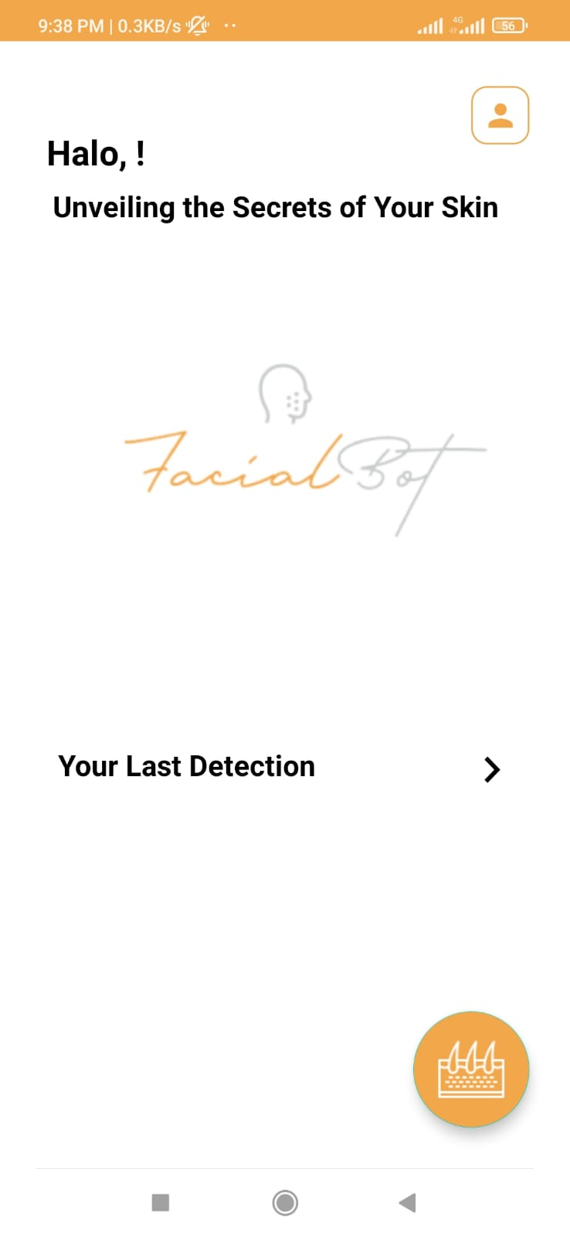
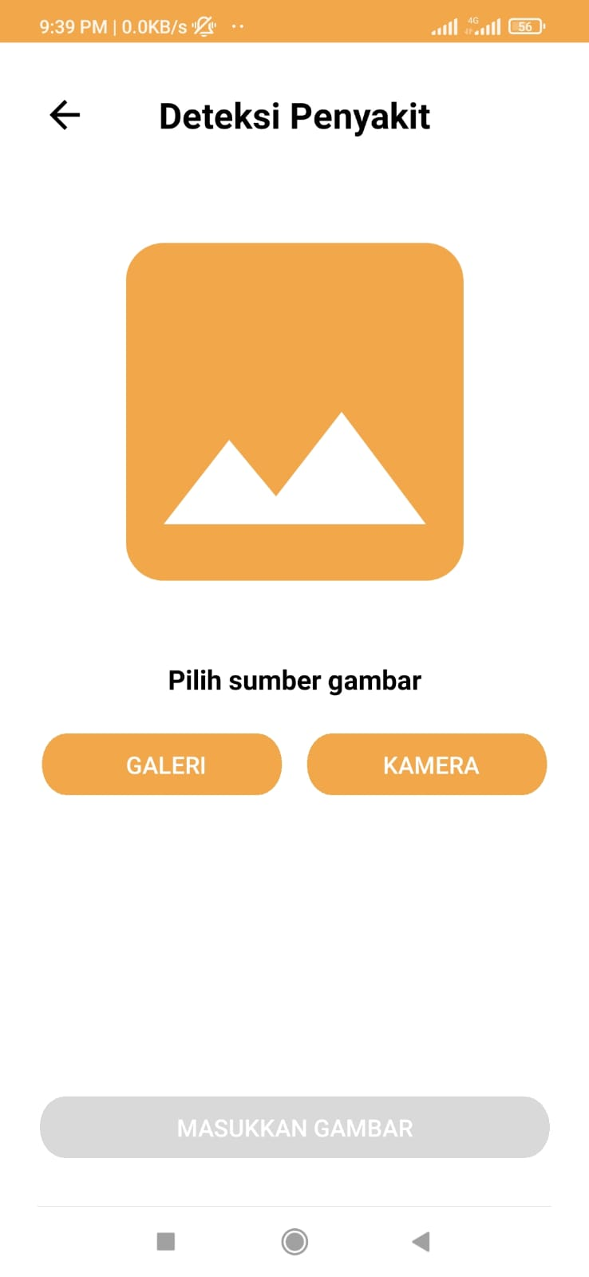
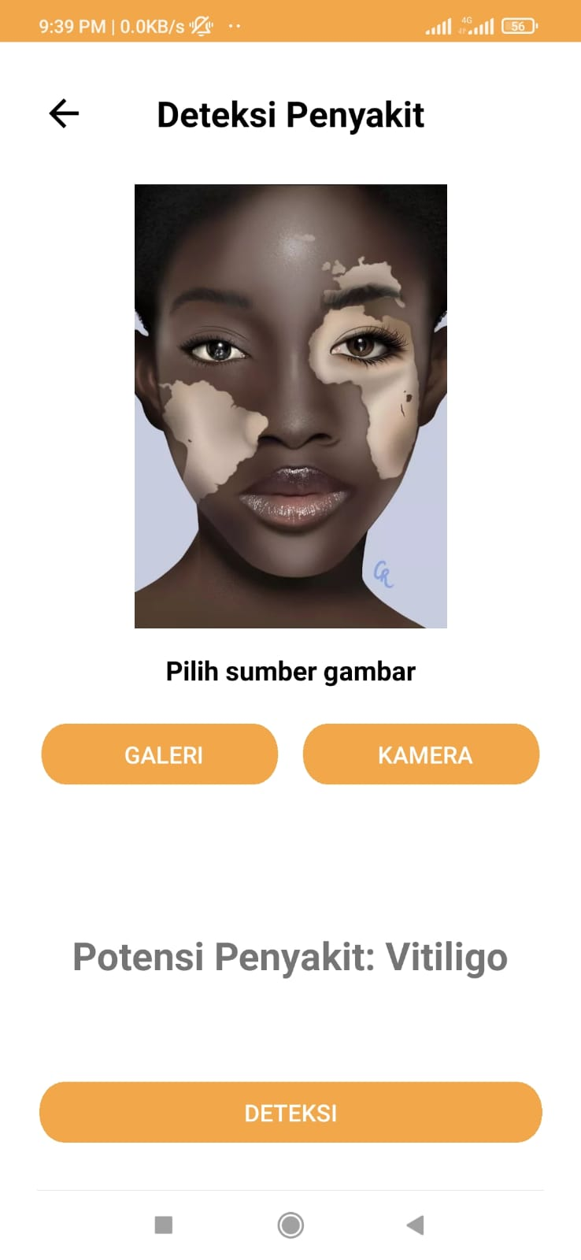
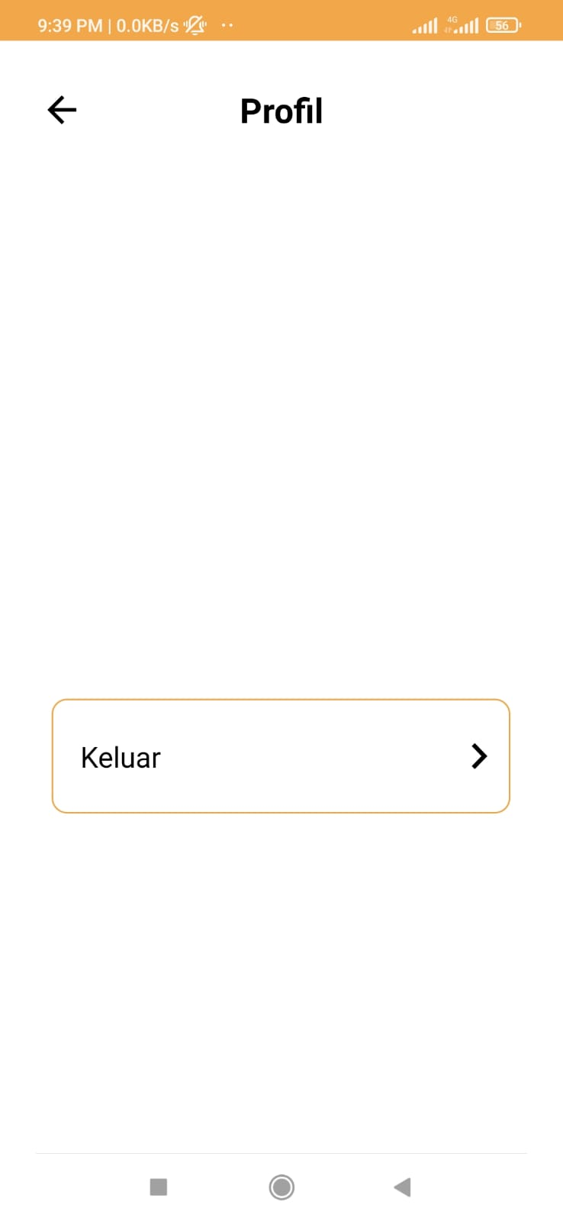
Android App

Slide 7
Timeline Project
6 - 11 May
22 - 28 May
5 - 11 June
Define Project Scope
EDA, storing dataset to database, and implementing the design
Creating API to send a image and receive the prediction and deploy.
Finding dataset, creating mobile UI, and test environment
Creating model architectures and rest API, and making a camera feature
Testing and evaluating the application.
16 - 21 May
29 May - 4 June
12 - 16 June

Slide 8


Competitor / Similar App
Derma App
Model Dermatol

Slide 9
COMPARASION TO SIMILIAR SERVICES/APPS
Aspects | FacialBot | Other similar services/apps
Detect Disease | Yes | Yes
Clinic Finder | Yes* | No
Recommendation System | For Product and Good Habit* | No
Expert Consultation Feature | Yes* | Yes
* To be added on future development

Slide 10
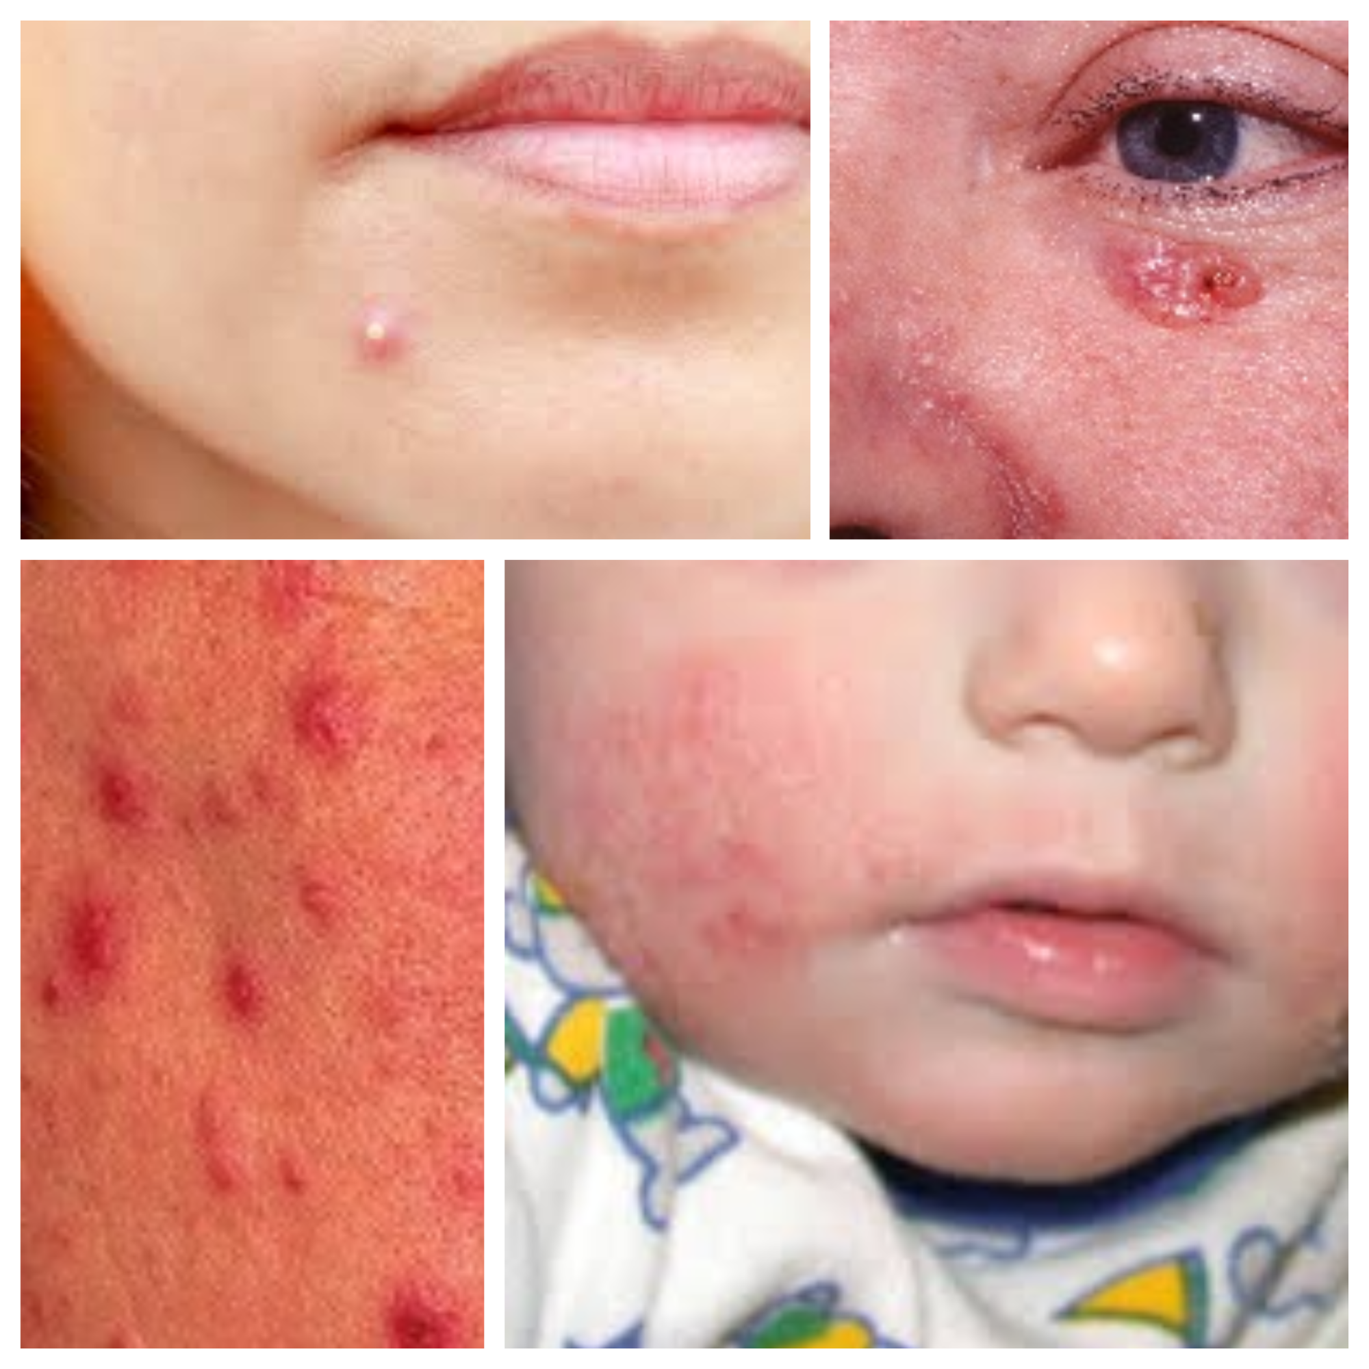
DATASET
We collected our datasets by scrapping Google Images.

Slide 11
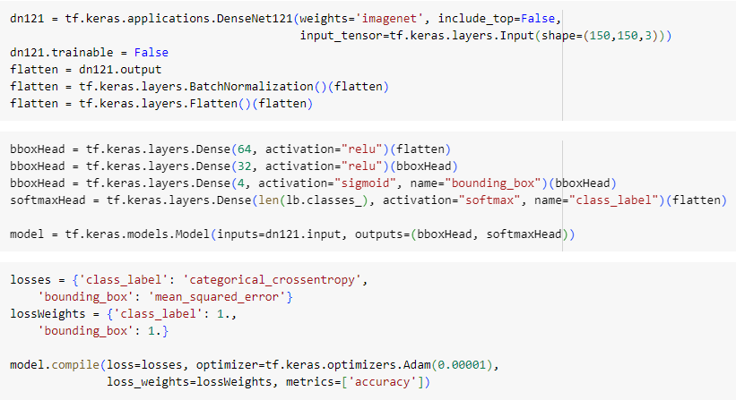
Model Architecture

Slide 12
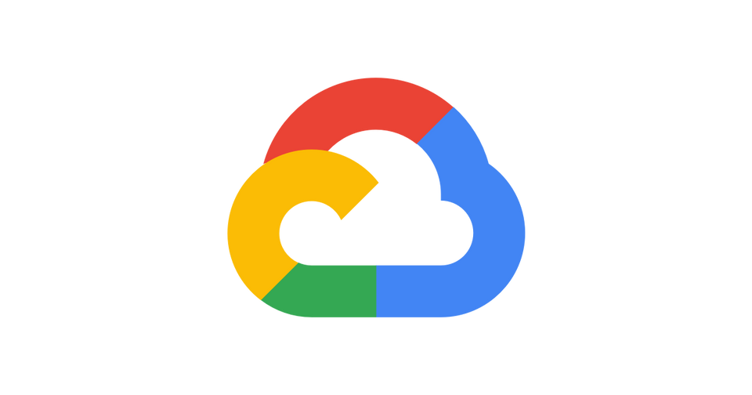
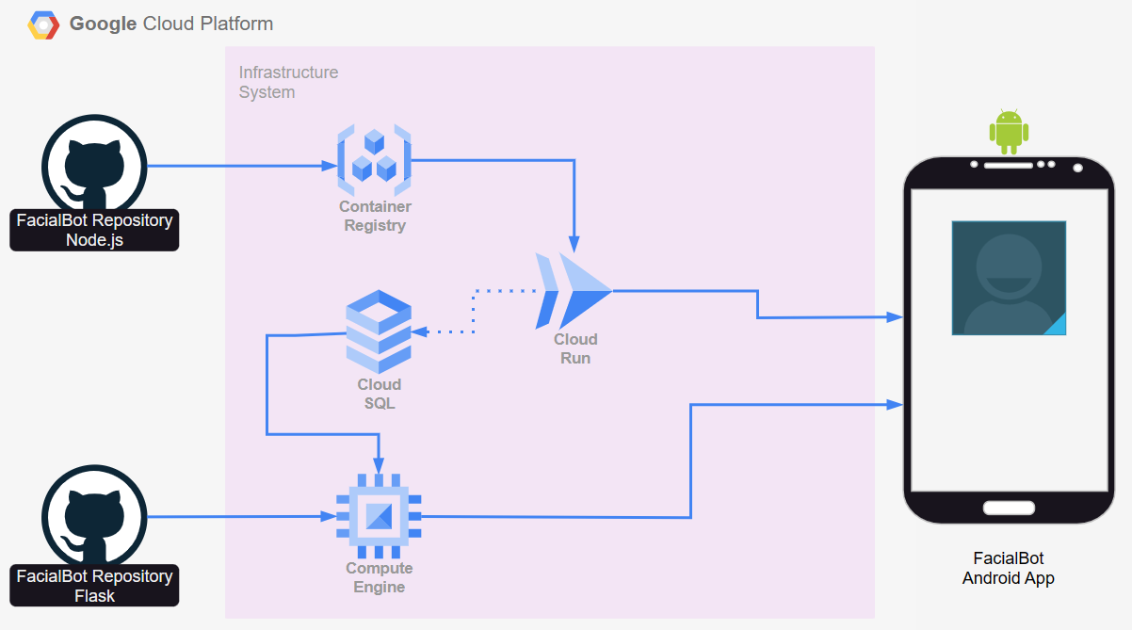
GCP Architecture

Slide 13
Project Milestones for 2023
MVP
(Now)
Product Development & Completion
(July)
Public Beta Test
(Sep-Oct)
Feedback Review + Feature Discussion
(Nov-Dec)

Slide 14
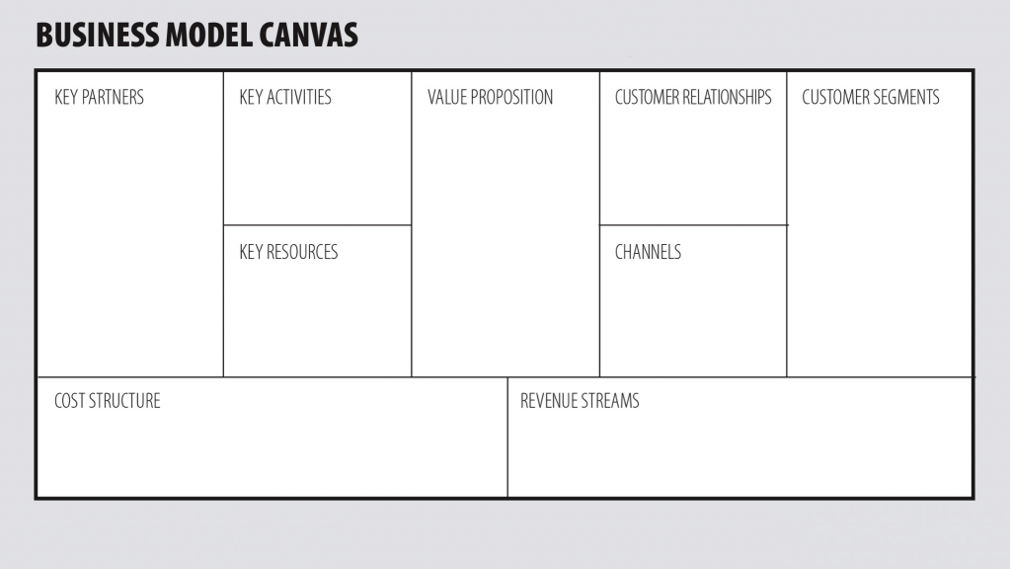
Hospital
Beauty Clinic
Companies in the health sector
High accuracy facial skin problem prediction.
The application can install in Android and easy to use.
Saving time and energy for user.
Small size application.
High accuracy prediction,
The application is user-friendly, so the user will feel comfortable while using the application.
People with all gender and any age who embarrassed and even afraid to consult a dermatologist
Google Cloud Platform Service.
Image facial skin problem from the user.
Social media platforms (Instagram, LinkedIn, Discord, etc.)
Google Cloud Platform Service Maintenance.
Partnership with company.
Ads in application.

Slide 15
Budgeting - 1 - USD 5k / IDR 75m
Category | Proportions* | Budget (max) in USD
Team Salary | 25% | $1.250 / Rp 18,000,000
Research / Operational Total | 75% | $3.750 / Rp 57,000,000
buying / renting things | 20% | $2000 / Rp 15,000,000
prototyping | 10% | $1000 / Rp 7,500,000
infrastructure | 15% | $1500 / Rp 11,250,000
survey / data collections | 5% | $500 / Rp 3,750,000
transportation expenses | 5% | $500 / Rp 3,7500,000
external experts, observer, respondents | 10% | $1000 / Rp 7,500,000
legalities, patent / copyright | 5% | $500 / Rp 3,750,000
productions preparations | 5% | $500 / Rp 3,750,000

Slide 16
Budgeting - 2 - USD 10k / IDR 140m
Category | Proportions | Budget (max) in USD
All aspects covered in Budgeting - 1 | 50% | $5.000 / Rp 70.000.000
Additional Budget for Team Salary | 15% | $1.500 / Rp 21.000.000
Additional Budget for Research/Ops | 20% | $2.000/ Rp 28.000.000
Marketing and Sales | 20% | $2.000 / Rp 28.000.000
Market research and competitive analysis | 10% | $1.000 / Rp 14.000.000
Future Development / R&D | 20% | $2.000 / Rp 28.000.000
Other Expenses (taxes, reserves) | 10% | $1.000 / Rp 14.000.000

